Slide 1

CSE413 – Security of Information Systems 2020 PhD Furkan Gözükara, Toros University https://github.com/FurkanGozukara/Security-of-Information-Systems-CSE413-2020
Lecture 1
Basic concepts in Information Security
Composed from Prof. Audun Jøsang, University of Oslo, Information Security 2018 Lectures
Source: https://www.uio.no/studier/emner/matnat/ifi/INF3510/v18/lectures/

Slide 2
Why study information security ?
Being an IT expert requires knowledge about IT security
Analogy: Building architects must have knowledge about fire safety
Developing IT systems without considering security will lead to vulnerable IT systems
IT experts without security skills are part of the problem
Learn about IT security to become part of the solution !
Security by Design is a prerequisite for privacy by design which is a legal requirement for processing personal data
Information security is a political issue
Often seen as a cost, but saves costs in the long term
Often given low priority in IT industry and IT education

Slide 3
Certifications for IS Professionals
Many different types of certifications available
vendor neutral or vendor specific
from non-profit organisations or commercial for-profit organisations
Certification gives assurance of knowledge and skills,
needed in job functions
gives credibility for consultants, applying for jobs, for promotion
Sometimes required
US Government IT Security jobs
Knowledge domains reflect current topics in IT Security
Generally kept up-to-date

Slide 4
ISACA Certifications
(Information Systems Audit and Control Association)
ISACA provides certification for IT professionals
CISM
CISA
CGIT
CRSIC
Certified Information Security Manager
Certified Information System Auditor
Certified in the Governance of Enterprise IT
Certified in Risk and Information Systems Control
CISM is the most popular ISACA security certification
IT auditors and consultants commonly have ISACA certifications
ISACA promotes IT governance framework COBIT
(Control Objectives for Information and Related Technologies)

Slide 5
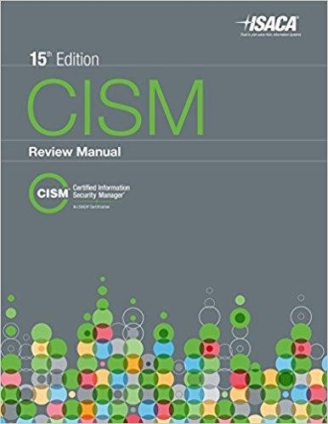
CISM: Certified Information Security Manager
Focuses on 4 domains of IS management
Information Security Governance
Information Risk Management
Information Security Program Development and Management
Information Security Incident Management
Official prep manual published by ISACA
– https://www.isaca.org/bookstore/
Price: US $115 ($85 for ISACA members)

Slide 6
CISM Exam
Exams normally twice per year worldwide
2018 exam information to give you an idea
Next exam in Oslo (and worldwide): June 2018
Deadline for registering: April 2018
Register for exam at www.isaca.org
Exam fee approx. US $500
Multiple choice exam
Requires 5 years professional experience
Yearly CISM maintenance fee approx. US $100
Requires 120 hours “practice time” per 3 years
6

Slide 7
(ISC)² Certifications
International Information Systems Security Certification Consortium
(ISC)² provides certification for information security professionals
CISSP
ISSAP
ISSMP
ISSEP
CAP
SSCP
CSSLP
Certified Information Systems Security Professional
Information Systems Security Architecture Professional
Information Systems Security Management Professional
Information Systems Security Engineering Professional
Certification and Accreditation Professional
Systems Security Certified Practitioner
Certified Secure Software Lifecycle Professional
CISSP is the most common IT security certification
– Most IT Security Consultants are CISSP

Slide 8
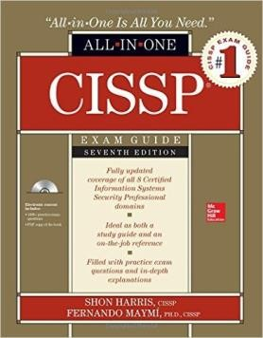
CISSP Exam:
Certified Information System Security Professional
Many different books to prepare for CISSP exam
e.g. text book used for INF3510 course
CISSP All-in-One Exam Guide 7th Edition, 2016
Author: Shon Harris and Fernando Maymí
€ 560 fee to sit CISSP exam
Exam through http://www.pearsonvue.com/isc2/
Test Centre in Oslo: http://www.glasspaper.no/
Brynsveien 12, Bryn, Oslo
Most of the of the material presented in the INF3510 course is taken from the syllabus of the CISSP CBK (Common Body of Knowledge).

Slide 9
CISSP CBK (Common Body of Knowledge)
8 domains
Security and Risk Management (Security, Risk, Compliance, Law, Regulations, and Business Continuity)
Asset Security (Protecting Security of Assets)
Security Engineering (Engineering and Management of Security)
Communication and Network Security (Designing and Protecting Network Security)
Identity and Access Management (Controlling Access and Managing Identity)
Security Assessment and Testing (Designing, Performing, and Analyzing Security Testing)
Security Operations (Foundational Concepts, Investigations, Incident Management, and Disaster Recovery)
Software Development Security (Understanding, Applying, and Enforcing Software Security)

Slide 10
Security Surveys
Useful for knowing the trend and current state of information security threats and attacks
Verizon Data Breach Report:
http://www.verizonenterprise.com/DBIR/
PWC security survey:
http://www.pwc.com/gx/en/issues/cyber-security/information-security-survey.html
Mnemonic Security Report
https://www.mnemonic.no/security-report/
Mørketallsundersøkelsen;
http://www.nsr-org.no/moerketall/
– New report in December every 2 years (even years).
+ many others

Slide 11
Security Advisories
Useful for managing threats and vulnerabilities
NorCERT: For government sector: https://www.nsm.stat.no/
NorSIS: For private sector: http://www.norsis.no/
FinansCERT: http://www.finanscert.no/
KraftCERT: https://www.kraftcert.no/
HelseCERT: https://www.nhn.no/tema/sikkerhet/HelseCERT/Sider/default.aspx
UNINETT-CERT: https://www.uninett.no/cert
UiO-CERT: http://www.uio.no/english/services/it/security/cert/
US CERT: http://www.cert.org/
Australia AusCERT: http://www.auscert.org.au/
+ many others

Slide 12
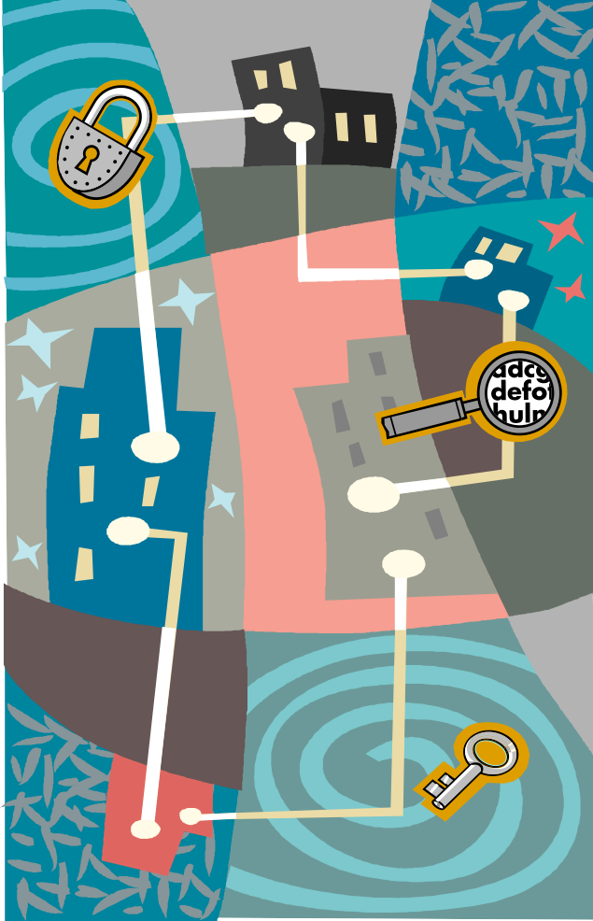
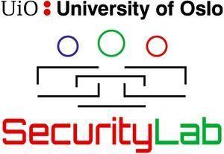
Academic Forum on Security
Monthly seminar on information security
https://wiki.uio.no/mn/ifi/AFSecurity/
Guest expert speakers
Next AFSecurity seminar:
Topic: History of Cryptology in Norway
Speaker: Sondre Rønjom, NSM
Time: January 2018
Place: Kristen Nygaards sal, 5th floor, OJD
All interested are welcome !
Organised by SecurityLab

Slide 13
Information Security Basic Concepts

Slide 14
What is security in general
Security is about protecting assets from damage or harm
Focuses on all types of assets
Example: your body, possessions, the environment, the nation
Security and related concepts
National security (political stability)
Safety (health)
Environmental security (clean environment)
Information security
etc.

Slide 15
What is Information Security
Information Security focuses on protecting assets from damage or harm
What are the assets to be protected?
information
– Example: data files, software, IT equipment and infrastructure
Covers both intentional and accidental events
Threat agents can be people or acts of nature
People can cause harm by accident or by intent
Information Security defined:
The preservation of confidentiality, integrity and availability of information; in addition, other properties such as authenticity, accountability, non-repudiation and reliability can also be involved. (ISO27000 Information Security Management Systems
- Overview and Vocabulary)

Slide 16
Scope of information security
IS management has as goal to avoid damage and to control risk of damage to information assets
IS management focuses on:
Understanding threats and vulnerabilities
Managing threats by reducing vulnerabilities or threat
exposures
Detection of attacks and recovery from attacks
Investigate and collect evidence about incidents (forensics)

Slide 17
The Need for Information Security
Why not simply solve all security problems once for all?
Reasons why that’s impossible:
Rapid innovation constantly generates new technology with new vulnerabilities
More activities go online
Crime follows the money
Information security is a second thought when developing IT
New and changing threats
More effective and efficient attack technique and tools are being developed
Conclusion: Information security doesn’t have a final goal, it’s a continuing process

Slide 18
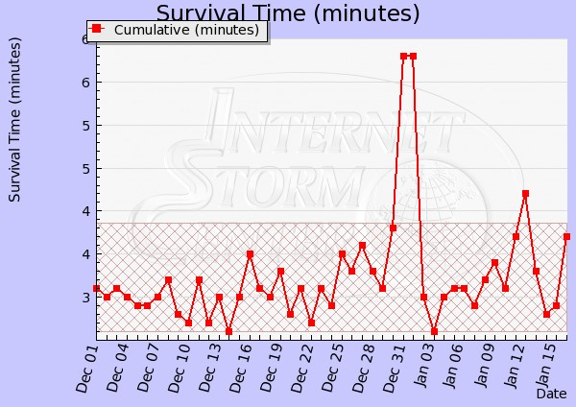
Internet Storm Survival Time Measure
The survival time is calculated as the average time between attacks against average target IP address. http://isc.sans.org/survivaltime.html

Slide 19
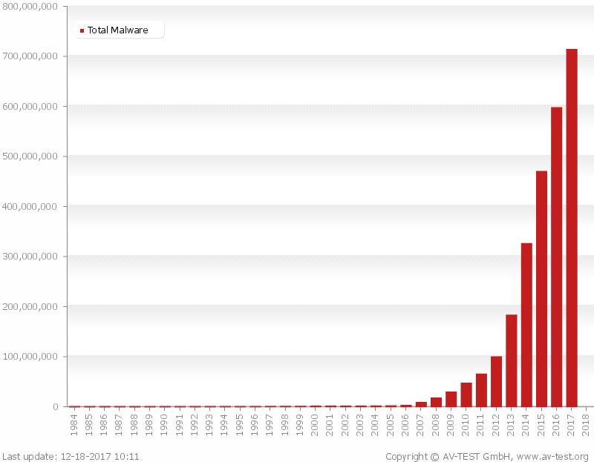
Malware Trend
L01 - INF3510 Information Security 32

Slide 20

Security control categories
Information Security
Physical controls
Facility protection
Security guards
Locks
Monitoring
Environmental controls
Intrusion detection
Technical controls
Logical access control
Cryptographic controls
Security devices
User authentication
Intrusion detection
Forensics
Administrative controls
Policies & standards
Procedures & practice
Personnel screening
Awareness training
Secure System Dev.
Incident Response

Slide 21
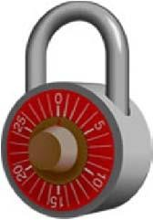


Security control functional types
Preventive controls:
prevent attempts to exploit vulnerabilities
Example: encryption of files
Detective controls:
warn of attempts to exploit vulnerabilities
Example: Intrusion detection systems (IDS)
Corrective controls:
correct errors or irregularities that have been detected.
Example: Restoring all applications from the last known good image to bring a corrupted system back online
Use a combination of controls to help ensure that the organisational processes, people, and technology operate within prescribed bounds.

Slide 22
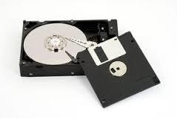
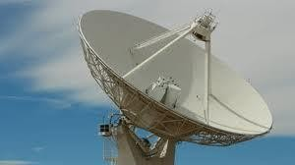
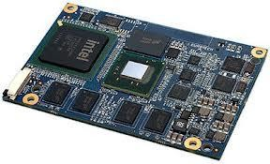
Controls by Information States
Information security involves protecting information
assets from harm or damage.
Information is considered in one of three possible states:
During storage
Information storage containers
Electronic, physical, human
During transmission
Physical or electronic
During processing (use)
Physical or electronic
Security controls for all information states are needed

Slide 23
Security Services and Properties
A security service provides a high level security property
The traditional definition of information security is to preserve the three CIA properties for data and services:
Confidentiality:
Integrity
Availability:
Information Security
Availability
CIA are the three main security properties/services
Data privacy is an additional property which assumes CIA
Data Privacy

Slide 24


Security services and controls
Security services (aka. goals or properties)
implementation independent
supported by specific controls
Security controls (aka. mechanisms)
Practical mechanisms, actions, tools or procedures that are used to provide security services
Security services:
e.g. Confidentiality – Integrity – Availability
support Security controls:
e.g. Encryption – Firewalls – Awareness

Slide 25
Confidentiality
The property that information is not made available or disclosed to unauthorized individuals, entities, or processes. (ISO 27000)
Can be divided into:
Secrecy: Protecting business data
Privacy: Protecting personal data
Anonymity: Hide who is engaging in what actions
Main threat: Information theft, unintentional disclosure
Controls: Encryption, Access Control, Perimeter defence
As general controls, also include:
Secure Systems Development, Incident Response

Slide 26
Integrity
Data Integrity: The property that data has not been altered or destroyed in an unauthorized manner.
(X.800: Security Architecture for OSI)
System Integrity: The property of accuracy and completeness (ISO 27000).
Can include the accountability of actions.
Threats: Data and system corruption, loss of accountability
Controls:
Hashing, cryptographic integrity check and encryption
Authentication, access control and logging
Software digital signing
Configuration management and change control (system integrity)
As general controls, also include:
Secure System Development, Incident Response

Slide 27
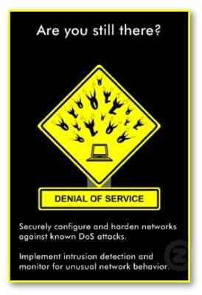
Availability
The property of being accessible and usable upon demand by an authorized entity.
(ISO 27000)
Main threat: Denial of Service (DoS)
The prevention of authorized access to resources or the delaying of time critical operations
Controls:
Redundancy of resources,
Load balancing,
Software and data backups
As general controls, also include:
Secure System Development and Incident Response

Slide 28


Data Privacy
To protect specific aspects of information that may be related to natural persons (personal information).
Prevent unauthorized collection and storage of personal
information
Prevent unauthorized use of collected personal information
Make sure your personal information is correct
Ensure transparency and access for data subjects
Provide adequate information security (CIA) around personal information
Define clear responsibilities around personal information
GDPR becomes EU law on 25 May 2018
10101
(General Data Protection Regulation)
01101101
10110

Slide 29



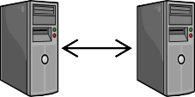

Authenticity
(Security Service)
The CIA properties are quite general security services.
Other security services are often mentioned. Authentication is very important, with various types:
User authentication:
The process of verifying a claimed identity of a (legal) user when accessing a system or an application.
Organisation authentication:
The process of verifying a claimed identity of a (legal) organisation in an online interaction/session
System authentication (peer entity authentication):
The corroboration (verification) that a peer entity (system) in an
association (connection, session) is the one claimed (X.800).
Data origin authentication (message authentication):
The corroboration (verification) that the source of data received is as claimed (X.800).

Slide 30



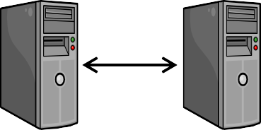
Taxonomy of Authentication
Authentication
Entity Authentication
Data Authentication
MAC,
DigSig&PKI
User
Authentication
Organisation
Authentication
System
Authentication
passwords, tokens,
OTP, biometrics, PKI
crypto protocols,
e.g. TLS, PKI
crypto protocols,
e.g. IPSec, PKI

Slide 31
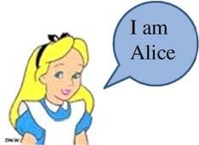
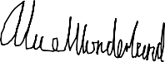
User Identification and Authentication
Identification
Who you claim to be
Method: (user)name, biometrics
User authentication
Prove that you are the one you claim to be
Main threat: Unauthorized access
Controls:
Passwords,
Personal cryptographic tokens,
OTP generators, etc.
Biometrics
Id cards
Alice Wonderland
D.O.B. 31.12.1985 Cheshire, England
Student nr.33033 University of Oxford
Authentication token
– Cryptographic security/authentication protocols

Slide 32


Organisation/System Authentication
Goal
– Establish the correct identity of organisations/remote hosts
Main threat:
Network intrusion
Masquerading attacks,
Replay attacks
(D)DOS attacks
Controls:
Host A
Host B
Cryptographic authentication protocols based on hashing and encryption algorithms
Examples: TLS, VPN, IPSEC

Slide 33

Data Origin Authentication (Message authentication)
Goal: Recipient of a message (i.e. data) can verify the correctness of claimed sender identity
But 3rd party may not be able to verify it
Main threats:
False transactions
False messages and data
Controls:
Encryption with shared secret key
MAC (Message Authentication Code)
Security protocols
Digital signature with private key
Electronic signature,
i.e. any digital evidence

Slide 34
Non-Repudiation
(Strong form of Data Authentication)
Goal: Making sending and receiving messages undeniable through unforgible evidence.
Non-repudiation of origin: proof that data was sent.
Non-repudiation of delivery: proof that data was received.
NB: imprecise interpretation: Has a message been received and read just because it has been delivered to your mailbox?
Main threats:
Sender falsely denying having sent message
Recipient falsely denying having received message
Control: digital signature
Cryptographic evidence that can be confirmed by a third party
Data origin authentication and non-repudiation are similar
Data origin authentication only provides proof to recipient party
Non-repudiation also provides proof to third parties

Slide 35
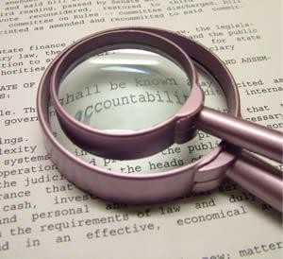
Accountability
(Can be considered as a part of System integrity)
Goal: Trace action to a specific user and hold them responsible
Audit information must be selectively kept and protected so that actions affecting security can be traced to the responsible party
(TCSEC/Orange Book)
Main threats:
Inability to identify source of incident
Inability to make attacker responsible
Controls:
Identify and authenticate users
Log all system events (audit)
Electronic signature
Non-repudiation based on digital signature
Forensics

Slide 36
Authorization
Authorization is to specify access and usage permissions for entities, roles or processes
Authorization policy normally defined by humans
Issued by an authority within the domain/organisation
Authorities authorize, systems don’t
Authority can be delegated
Management → Sys.Admin
Implemented in IT systems as configuration/policy

Slide 37
Identity and Access Management (IAM) Phases
Configuration phase
Operation phase
Termination phase
Registration
of identity
Self- Identification
De-registration
Claim identity
Provisioning of credentials
Authentication
Prove claimed identity
Deactivate credentials
Enforce access authorization policy
Revoke authorization
Authorization
of access
Access control

Slide 38
Confusion about Authorization
The term “authorization” is often wrongly used in the sense of “access control”
e.g. misleading figure on p.725 in Harris 7th ed.
Common in text books and technical specifications (RFC 2196 …)
Cisco AAA Server (Authentication, Authorization and Accounting)
Wrong usage of “authorization” leads to absurd scenario:
You get somebody’s password, and uses it to access account.
Login screen gives warning: “Only authorized users may access this system”.
You get caught and taken to the police
You argue: “Text books in security state that a system authorizes the user when typing the right password, hence I was authorized because I typed the right password”.
Case dismissed, you go free.

Slide 39





Identity and Access Management Concepts
System Owner Domain
User
registration
1
2
provisioning
3
authorization
PAP
log-on
Id
Cr
Identity Provider System Owner
policy
request
+
User
authentication
function
7
PDP
6
4
request resource &
access type
decision
request
access
8
PEP
5
System resource
Access control function
PAP: Policy Administration Point | PEP: Policy Enforcement Point | Registration
PDP: Policy Decision Point | IdP: Identity Provider | Operations

Slide 40
End of lecture

